Slide 1

CMR TECHNICAL CAMPUS UGC AUTONOMOUS (Accredited by NAAC, NBA, Permanently Affiliated to JNTUH, Approved by AICTE, New Delhi) Kandlakoya (V), Medchal Road, Hyderabad-501401. DEPARTMENT OF COMPUTER SCIENCE AND ENGINEERING
Application and evaluation of a K-Medoids based shape clustering
method for an articulated design space
Batch-10
PRESENTED By: Under the Guidance of
217R1A0551 SANIYA Dr.V.Naresh Kumar
217R1A0557 THAGURAPU RAGHUVARAN (Asst,Professor, CSE HOD-II)
217R1A0548 ROUTHU HARSHA VARDHAN

Slide 2
TABLE OF CONTENTS
Introduction
Overview of the Project
Existing Project
Disadvantages
Proposed System
Advantages
Hardware Requirements
Software Requirements
Novelty of the Project
Architecture
Modules
UML Daigrams
Sample Code
Result
Conclusion
Future Scope
References
Github Link

Slide 3
INTRODUCTION
Generative Design Systems (GDSs): These computational frameworks often generate a large number of designs, making it difficult for designers to explore effectively.
Issue: Existing systems lack mechanisms to organize designs,leading to redundancy and computational burden.
Solution: The introduction of K-Medoids clustering for grouping designs into subsets for better exploration .

Slide 4
OVERVIEW OF THE PROJECT
To develop and apply a K-Medoids-based clustering method (SC-KM) that organizes 2D architectural shapes. This method is designed to handle non-Euclidean distances and improve design space exploration

Slide 5
EXISTING PROJECT
Existing Systems: Traditional generative design systems produce numerous redundant designs, making navigation difficult.
Challenge: Lack of an organizational mechanism for effective design exploration

Slide 6
DISADVANTAGES
Scalability issues
Lack of adaptability
Redundancy
Computational Burden

Slide 7
PROPOSED SYSTEM
SC-KM Method: The proposed system utilizes K-Medoids clustering to group similar designs and reduce redundancy.
New Algorithms: The project introduced a grid_x0002_based shape descriptor and the use of the Hungarian algorithm for shape difference calculation

Slide 8
ADVANTAGES
High Stability
High Accuracy
Robustness to Noise
Cluster Representation

Slide 9
HARDWARE REQUIREMENTS
System : Pentium IV 2.4GHz or Greater
Harddisk : 40GB or More
RAM : 512MB or More
SOFTWARE REQUIREMENTS
Code Language : Python
Operating System : Windows 7 Professional or Later

Slide 10
NOVELTY OF THE PROJECT
Novel Approach: The SC-KM method introduces a new approach for shape clustering, focusing on architectural designs.
New Algorithms: A unique combination of grid_x0002_based descriptors and the Hungarian algorithm to compare shape differences

Slide 11
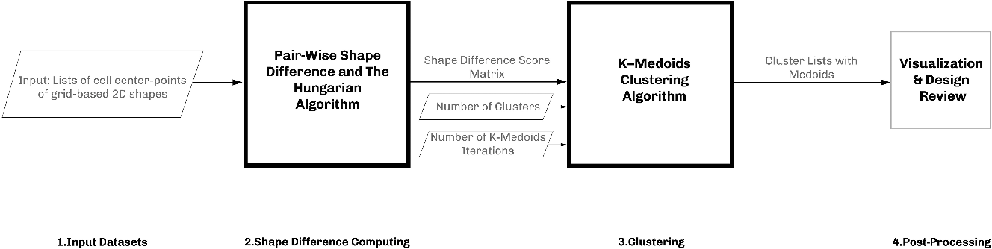
ARCHITECTURE

Slide 12
MODULES
Upload dataset: Users upload dataset of architectural shapes.
Preprocess & Hamming distance calculation : Shapes are processed and hamming distances are calculated for comparsion.
K-Medoids Clustering : Clusters similar shapes and identifies representative designs.
Visualization : Visualizes the clustering results and provides insights into similar shapes.

Slide 13
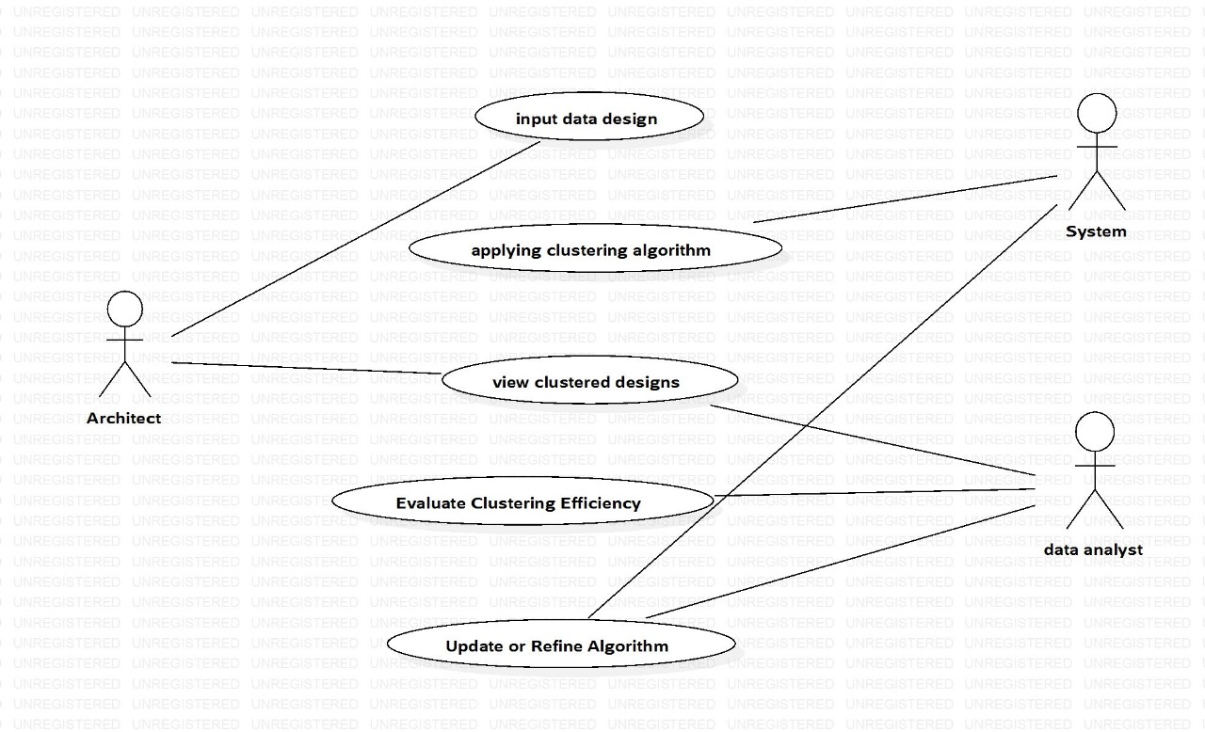
UseCase Diagram:

Slide 14
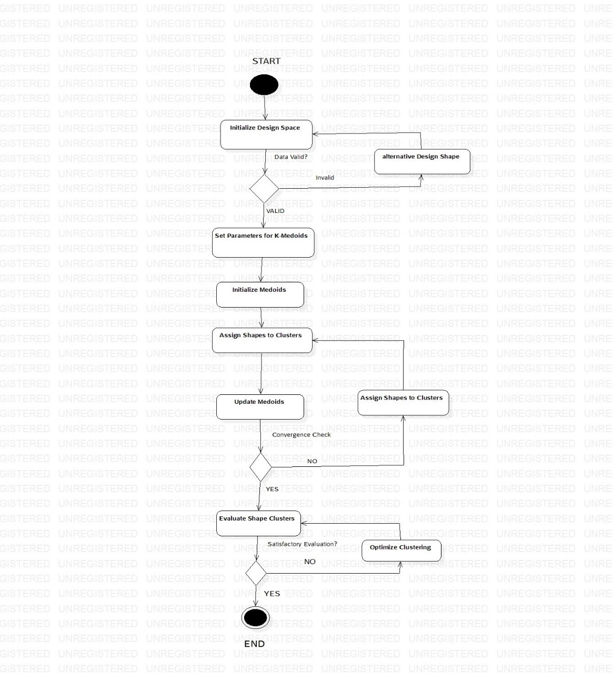
Activity Diagram:

Slide 15
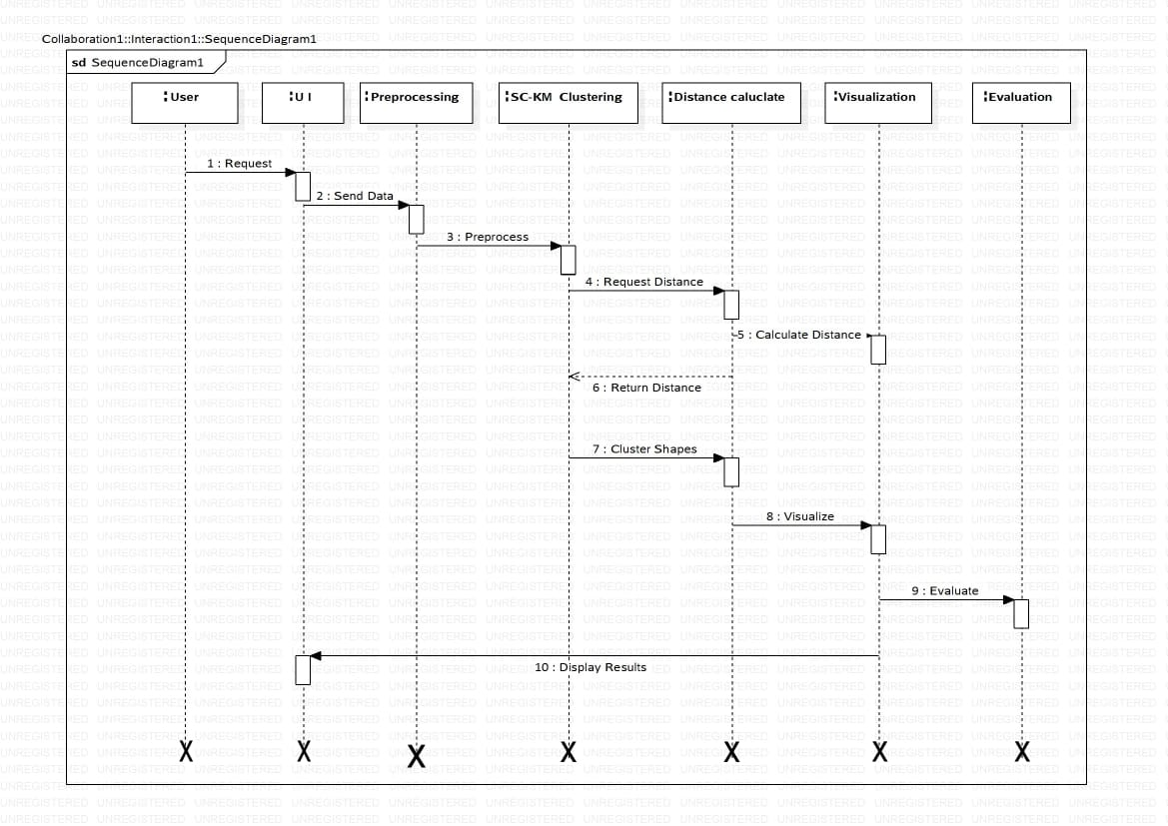
Sequence Diagram:

Slide 16
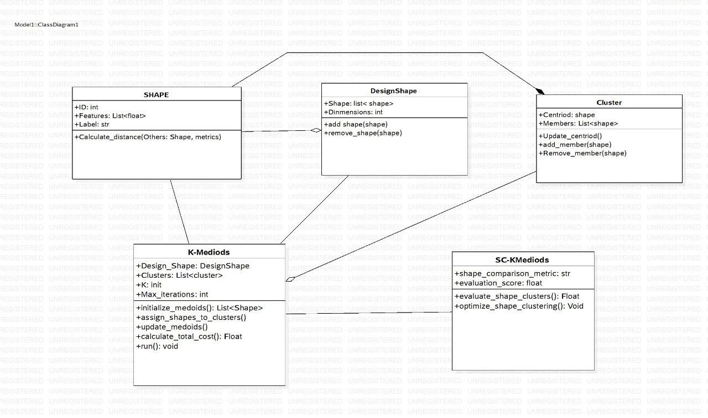
Class Diagram:

Slide 17
SAMPLE CODE
from tkinter import *
import tkinter
from tkinter import filedialog
import matplotlib.pyplot as plt
from tkinter.filedialog import askopenfilename
import pandas as pd
import numpy as np
import os
import cv2
import numpy as np
from sklearn_extra.cluster import KMedoids
main = tkinter.Tk()
main.title("Application and evaluation of a K-Medoids-based shape clustering method for an articulated design space")
main.geometry("1200x1200")
global dataset
global X, Y, clusters, shape1, shape2, shape3, shape4
def uploadDataset():
global dataset
text.delete('1.0', END)
filename = filedialog.askdirectory(initialdir=".")
text.insert(END,str(filename)+" Dataset Loaded\n\n")
pathlabel.config(text=str(filename)+" Dataset Loaded\n\n")
def preprocessDataset():
text.delete('1.0', END)
global dataset
global X, Y
if os.path.exists("model/X.txt.npy"):
X = np.load('model/X.txt.npy')
Y = np.load('model/Y.txt.npy')
else:
X = []
Y = []
for root, dirs, directory in os.walk(dataset):
for j in range(len(directory)):
name = os.path.basename(root)
print(name+" "+root+"/"+directory[j])
if 'Thumbs.db' not in directory[j]:
img = cv2.imread(root+"/"+directory[j],0)
img = cv2.resize(img, (64,64))
X.append(img.ravel())
Y.append(getID(name))
X = np.asarray(X)
Y = np.asarray(Y)
np.save('model/X.txt',X)
np.save('model/Y.txt',Y)

Slide 18
X = X.astype('float32')
X = X/255
test = X[3]
test = test.reshape(64,64)
indices = np.arange(X.shape[0])
np.random.shuffle(indices)
X = X[indices]
Y = Y[indices]
text.insert(END,"Total images found in dataset : "+str(X.shape[0])+"\n\n")
text.insert(END,"Shapes found in dataset are : Star, Circle, Triangle and Rectangle\n\n")
text.update_idletasks()
test = cv2.resize(test,(300,300))
cv2.imshow("Sample Process Image",test)
cv2.waitKey(0)
def runClustering():
global X, Y, clusters
global shape1, shape2, shape3, shape4
text.delete('1.0', END)
kmedoids = KMedoids(n_clusters=4, metric='euclidean',random_state=0,max_iter=10000)
kmedoids.fit(X)
clusters = kmedoids.labels_
text.insert(END,"Clusters List = "+str(clusters.tolist())+"\n\n")
count1 = 0
count2 = 0
count3 = 0
count4 = 0
for i in range(len(clusters)):
if clusters[i] == 0:
count1 += 1
if len(shape1) < 20:
if clusters[i] == 0:
shape1.append(X[i])
shape2 = []
for i in range(len(clusters)):
if clusters[i] == 1:
count2 += 1
if len(shape2) < 20:
if clusters[i] == 1:
shape2.append(X[i])
shape3 = []
for i in range(len(clusters)):
if clusters[i] == 2:
count3 += 1
if len(shape3) < 20:
if clusters[i] == 2:
shape3.append(X[i])
shape4 = []
for i in range(len(clusters)):
if clusters[i] == 3:
count4 += 1
if len(shape4) < 20:
if clusters[i] == 3:
shape4.append(X[i])

Slide 19
text.insert(END,"Clustering process completed\n\n")
text.insert(END,"Total shapes found in Cluster1 : "+str(count1)+"\n\n")
text.insert(END,"Total shapes found in Cluster2 : "+str(count2)+"\n\n")
text.insert(END,"Total shapes found in Cluster3 : "+str(count3)+"\n\n")
text.insert(END,"Total shapes found in Cluster4 : "+str(count4)+"\n\n")
def plotShapes(array, titles):
w = 64
h = 64
fig = plt.figure(figsize=(8, 8))
columns = 4
rows = 5
index = 0
for i in range(1, columns*rows +1):
img = array[index].reshape(64,64)
fig.add_subplot(rows, columns, i)
plt.imshow(img)
index += 1
fig.suptitle(titles, fontsize=20)
def visualization():
global shape1, shape2, shape3, shape4
plotShapes(shape1,"Shapes in Cluster 1")
plotShapes(shape2,"Shapes in Cluster 2")
plotShapes(shape3,"Shapes in Cluster 3")
plotShapes(shape4,"Shapes in Cluster 4")
plt.show()
def close():
main.destroy()
font = ('times', 14, 'bold')
title = Label(main, text='Application and evaluation of a K-Medoids-based shape clustering method for an articulated design space')
title.config(bg='DarkGoldenrod1', fg='black')
title.config(font=font)
title.config(height=3, width=120)
title.place(x=5,y=5)
font1 = ('times', 12, 'bold')
uploadButton = Button(main, text="Upload Shapes Dataset", command=uploadDataset)
uploadButton.place(x=50,y=100)
uploadButton.config(font=font1)
pathlabel = Label(main)
pathlabel.config(bg='brown', fg='white')
pathlabel.config(font=font1)
pathlabel.place(x=560,y=100)
preprocessButton = Button(main, text="Preprocess & Hamming Distance Calculation", command=preprocessDataset)
preprocessButton.place(x=50,y=150)
preprocessButton.config(font=font1)
hybridMLButton = Button(main, text="Run K-Medoids Clustering Algorithm", command=runClustering)
hybridMLButton.place(x=50,y=200)
hybridMLButton.config(font=font1)
snButton = Button(main, text="Similar Shapes Visualization from Clusters", command=visualization)
snButton.place(x=50,y=250)
snButton.config(font=font1)
snButton = Button(main, text="Exit", command=close)
snButton.place(x=50,y=300)
snButton.config(font=font1)
font1 = ('times', 12, 'bold')
text=Text(main,height=25,width=100)
scroll=Scrollbar(text)
text.configure(yscrollcommand=scroll.set)
text.place(x=400,y=150)
text.config(font=font1)
main.config(bg='LightSteelBlue1')
main.mainloop()

Slide 20
#TEST TRAIN
import os
import cv2
import numpy as np
from sklearn_extra.cluster import KMedoids
import matplotlib.pyplot as plt
# Non-Binary Image Classification using Convolution Neural Networks
'''
path = 'shapes'
labels = []
X_train = []
Y_train = []
def getID(name):
index = 0
for i in range(len(labels)):
if labels[i] == name:
index = i
break
return index
for root, dirs, directory in os.walk(path):
for j in range(len(directory)):
name = os.path.basename(root)
if name not in labels:
labels.append(name)
print(labels)
for root, dirs, directory in os.walk(path):
for j in range(len(directory)):
name = os.path.basename(root)
print(name+" "+root+"/"+directory[j])
if 'Thumbs.db' not in directory[j]:
img = cv2.imread(root+"/"+directory[j],0)
img = cv2.resize(img, (64,64))
X_train.append(img.ravel())
Y_train.append(getID(name))
X_train = np.asarray(X_train)
Y_train = np.asarray(Y_train)
print(Y_train)
np.save('model/X.txt',X_train)
np.save('model/Y.txt',Y_train)
'''
X_train = np.load('model/X.txt.npy')
Y_train = np.load('model/Y.txt.npy')
X_train = X_train.astype('float32')
X_train = X_train/255
test = X_train[3]
test = test.reshape(64,64)
cv2.imshow("aa",test)
cv2.waitKey(0)
indices = np.arange(X_train.shape[0])
np.random.shuffle(indices)
X_train = X_train[indices]
Y_train = Y_train[indices]
kmedoids = KMedoids(n_clusters=4, metric='euclidean',random_state=0,max_iter=10000)
kmedoids.fit(X_train)
predict = kmedoids.labels_
images = []
for i in range(len(predict)):
if len(images) < 20:
if predict[i] == 0:
images.append(X_train[i])
images1 = []
for i in range(len(predict)):
if len(images1) < 20:
if predict[i] == 1:
images1.append(X_train[i])
images2 = []
for i in range(len(predict)):
if len(images2) < 20:
if predict[i] == 2:
images2.append(X_train[i])
images3 = []
for i in range(len(predict)):
if len(images3) < 20:
if predict[i] == 3:
images3.append(X_train[i])
def plotShapes(array, title):
w = 64
h = 64
fig = plt.figure(figsize=(8, 8))
columns = 4
rows = 5
index = 0
for i in range(1, columns*rows +1):
img = array[index].reshape(64,64)
fig.add_subplot(rows, columns, i)
plt.imshow(img)
index += 1
plt.title(title)
plt.show(
plotShapes(images,"Shapes in Cluster 1")
plotShapes(images1,"Shapes in Cluster 2")
plotShapes(images2,"Shapes in Cluster 3")
plotShapes(images3,"Shapes in Cluster 4")

Slide 21
RESULT

Slide 22
CONCLUSION
The project provides a practical solution for clustering shapes within the architectural domain, offering insights into the development of advanced design tools.
With the potential for future enhancements, this work stands as a significant contribution to the field of generative design systems and computational design.

Slide 23
FUTURE SCOPE
This method can be applied to other fields such as image processing or urban planning, providing a versatile tool for different domains that require shape clustering or generative design systems.
The system can also support integration with various databases and design software for more seamless data management and collaboration in the future.

Slide 24
REFERENCES
Cai, C., & Li, B. (2020). Cluster analysis for urban morphological analysis and case-based design. Paper presented at the ACADIA 2020: Distributed Proximities. Proceedings of the 40th Annual Conference of the Association for Computer Aided Design in Architecture (ACADIA)
Abdelrahman, M. M., & Toutou, A. M. Y. (2019). [ANT]: A machine learning approach for building performance simulation: Methods and development. The Academic Research Community Publication, 3(1), 205–213.
Brown, N. C., & Mueller, C. T. (2019). Quantifying diversity in parametric design: A comparison of possible metrics. Artificial Intelligence for Engineering Design, Analysis and Manufacturing: AIEDAM, 33(1), 40–53.
REFERENCES LINK
https://doi.org/10.5281/zenodo.888148
https://doi.org/10.4135/9781412986397

Slide 25
GITHUB LINK
https://github.com/Raghuvaran0557/Minor-Project

